Slide 1
WELCOME
TO
LPU ONLINE FRESHMEN INDUCTION

Slide 2
Lovely Professional University is a Private University established through the enactment of ‘The Lovely Professional University Act, 2005’ (Punjab Act No. 25 of 2005) by the State Legislature of Government of Punjab vide Notification No. 38-Leg./2005
Recognized by UGC under Section 2(f) of UGC Act 1956 vide Notification No. F.9-10/2006 (CPP-1) and also recognized by the concerned statutory bodies set up, in relevant diverse fields of higher education, by the Government of India such as NCTE, PCI, COA and BCI
Offers Programmes in various disciplines at Diploma, Undergraduate, Postgraduate, and Doctoral levels
Member of the Association of Indian Universities (AIU)
Member of prestigious international bodies including the Association of Commonwealth Universities and Accreditation Council for Business Schools & Programs

Slide 3
LEADERSHIP
Dr. Ashok K. Mittal
CHANCELLOR
Ms. Rashmi Mittal
PRO-CHANCELLOR

Slide 4
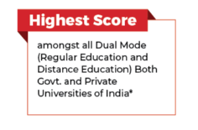
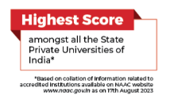
Rankings & Awards

Slide 5
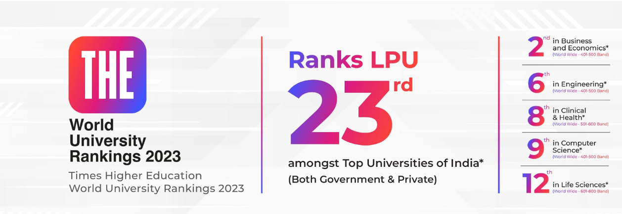
Rankings & Awards

Slide 6
Rankings & Awards

Slide 7
Infrastructure
Creation that Redefines groundwork with the latest Technology and Innovation
Based on the nature of their study programme, LPU Regular, Distance and Online Learners have equal access to various infrastructural and other facilities of the University.

Slide 8
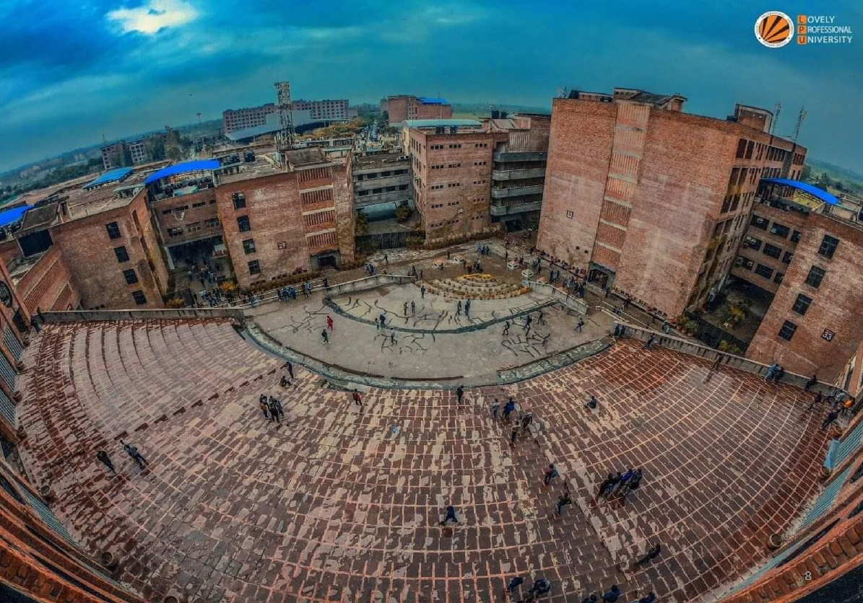
LPU, where Architecture is frozen music

Slide 9
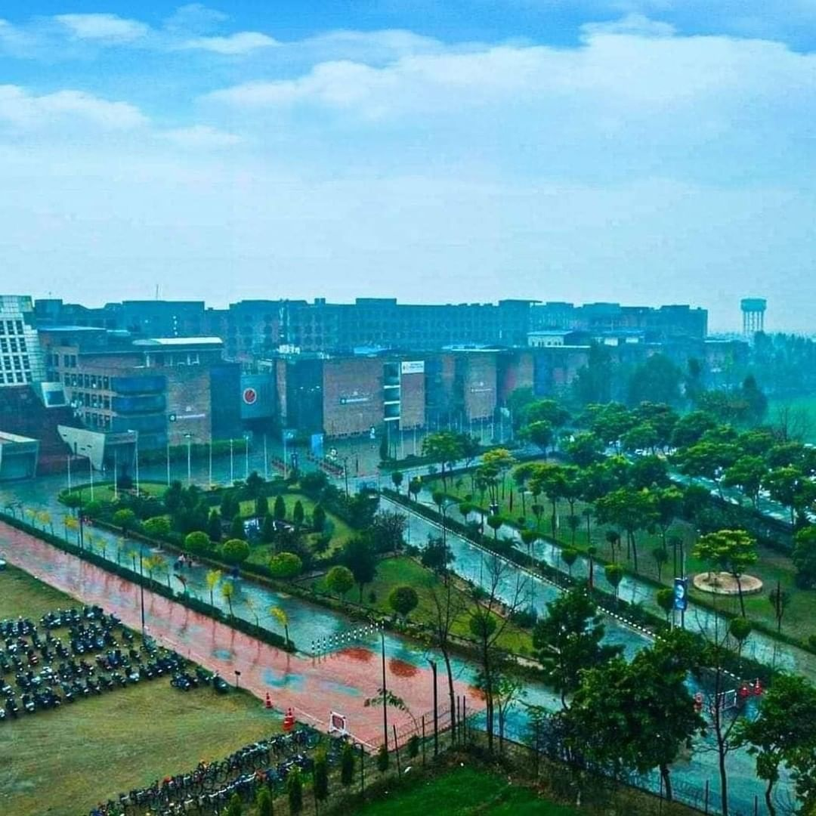
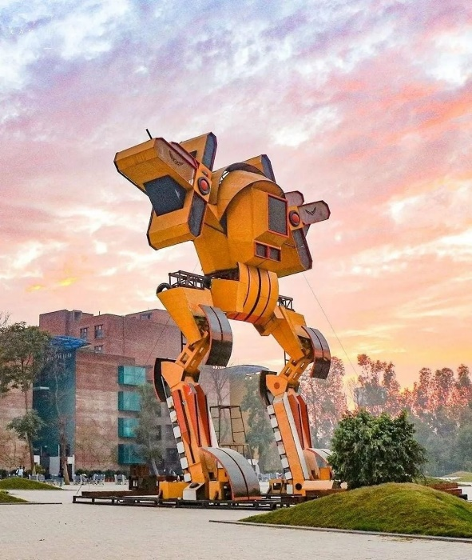
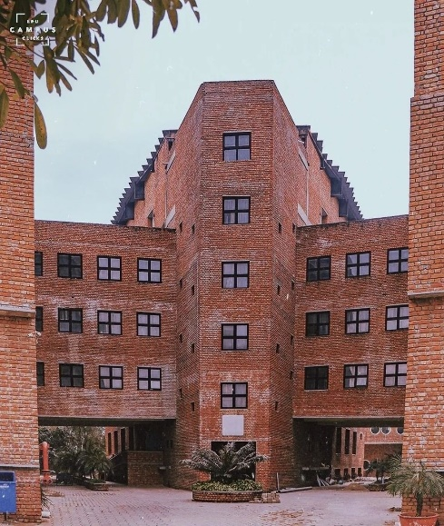

Slide 10
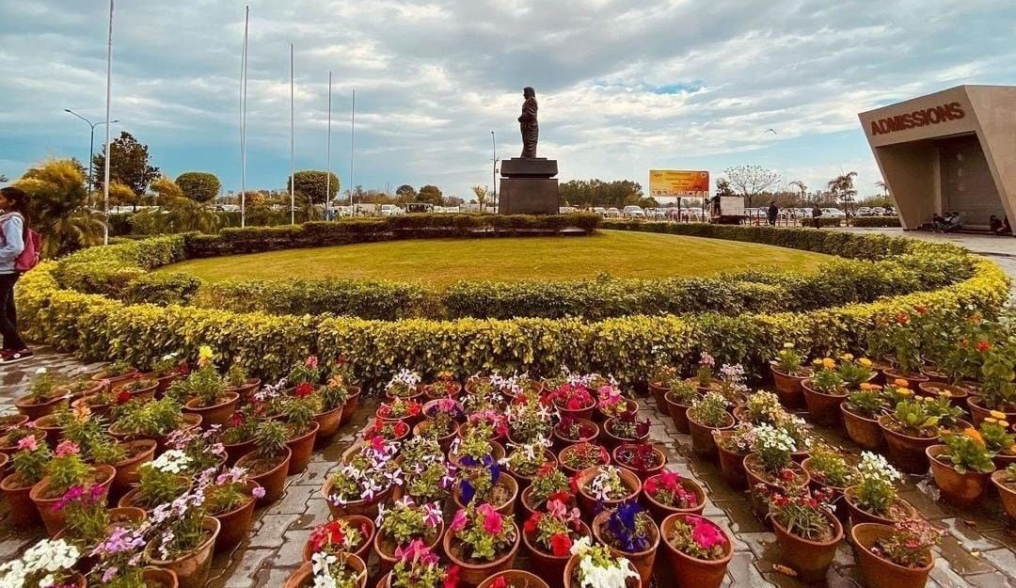
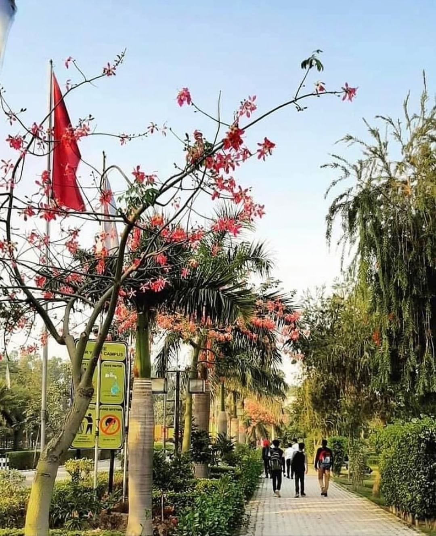
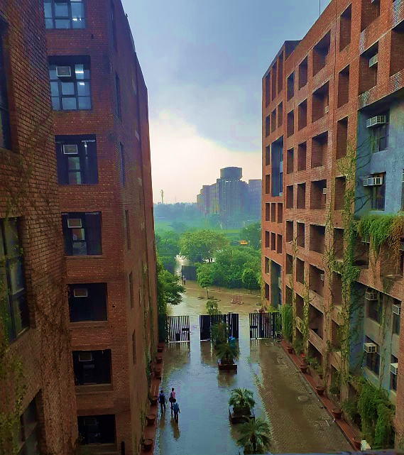
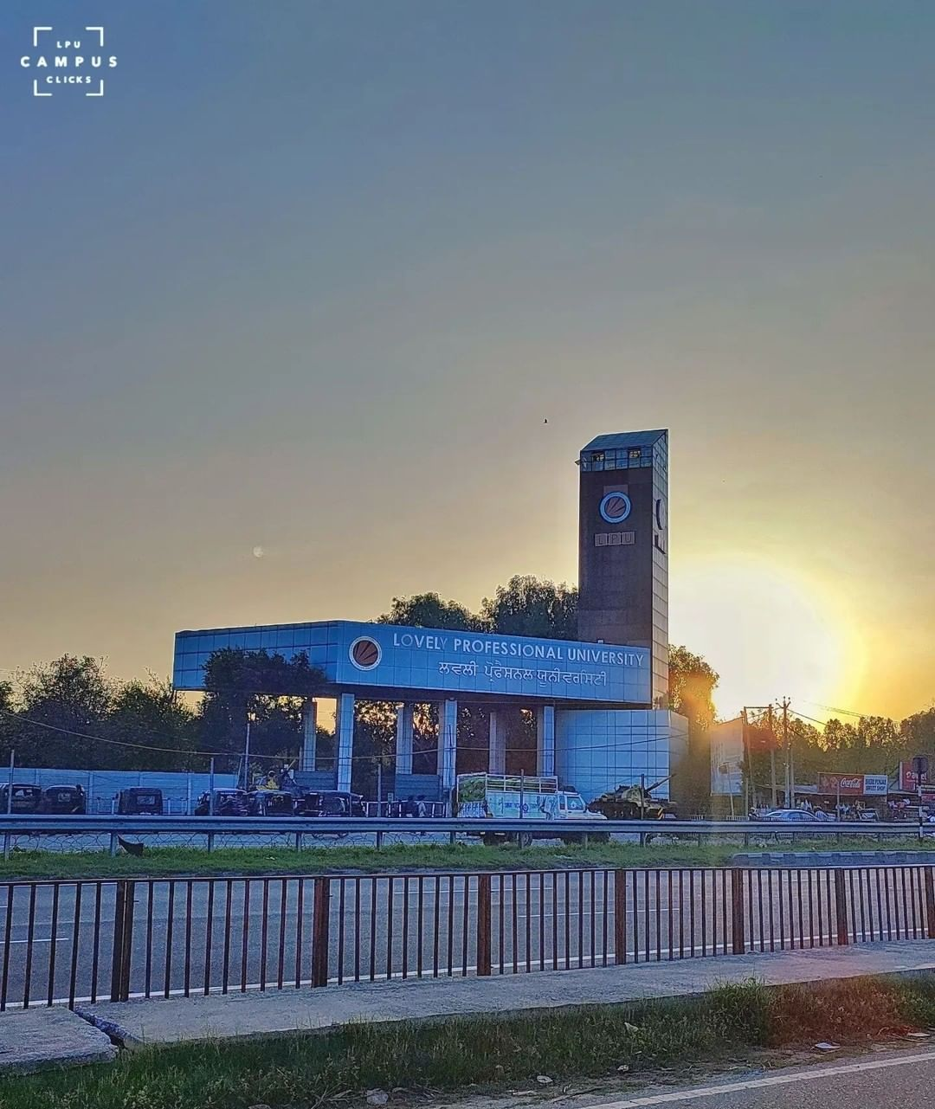

Slide 11
Largest Single Campus University in India with more than 90,000 Regular, Distance and Online students…
… from all States and 50+ countries

Slide 12
Our Faculty
4000 plus faculty members
Research oriented
Most of them are PhD holders
International Faculty
Rich in experience
Corporate Trainers
Industry and corporate background
Patent Holders

Slide 13
Unmatched Classrooms

Slide 14
State-of-the Art Computer Labs

Slide 15
Innovation Studio

Slide 16
Unimall: Your ALL - NEED store
Managed by our student entrepreneurs …
… offering unmatched shopping experience.

Slide 17
BALDEV RAJ MITTAL UNIPOLIS,
A power-packed place on the campus with a capacity to accommodate several thousand people

Slide 18
Shanti Devi Mittal Auditorium
Capacity to accommodate 3500 people
Centrally air - conditioned
Fully soundproof set up
Equipped with latest technology
Hosted events like 106th Indian Science Congress, Convocations, One World, One India, Youth Vibe, etc.

Slide 19
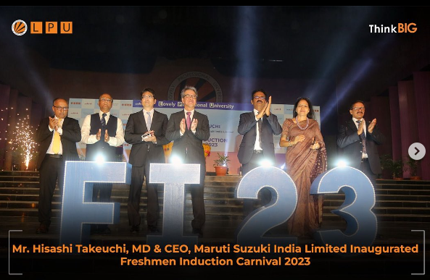
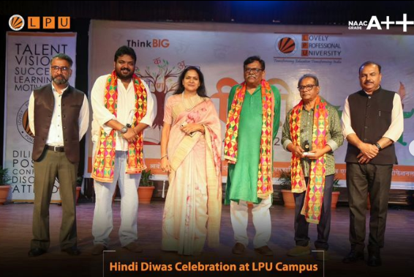
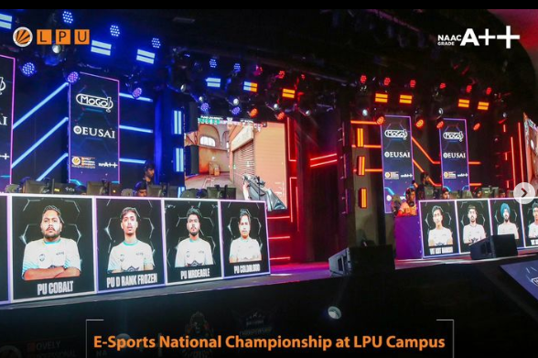
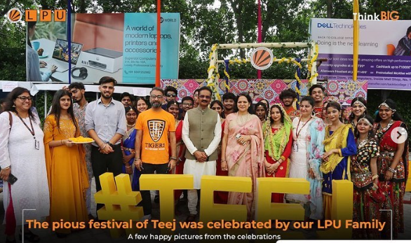
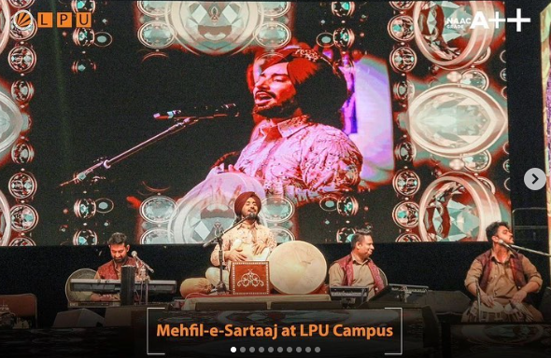
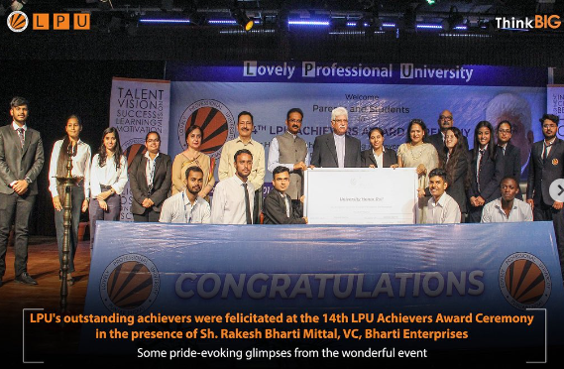
Recent Events at LPU

Slide 20
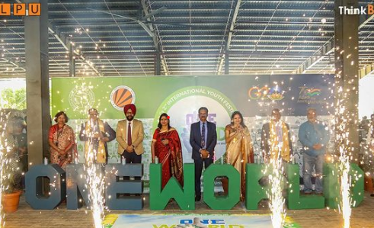
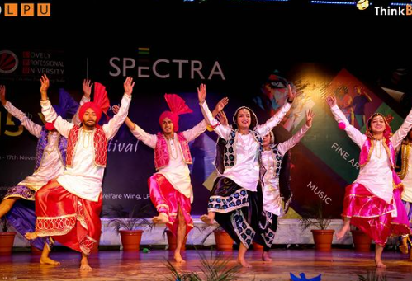
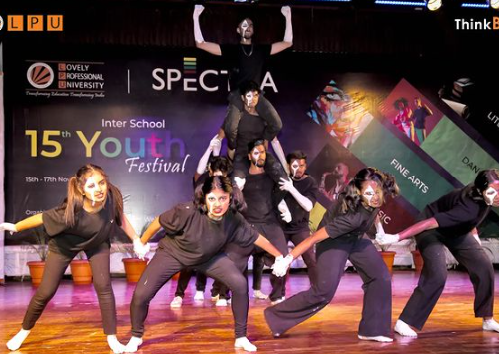
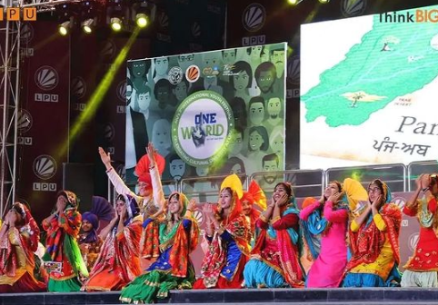
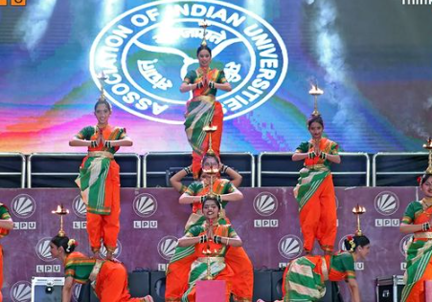
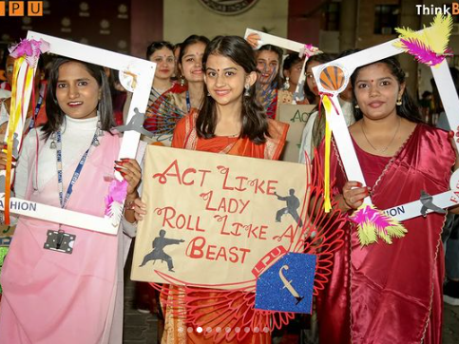
Events at LPU

Slide 21
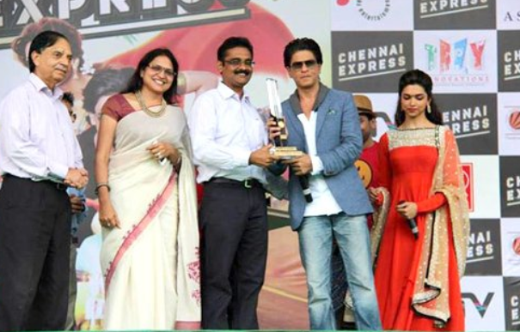
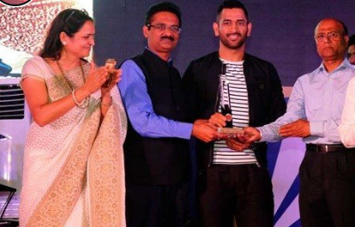
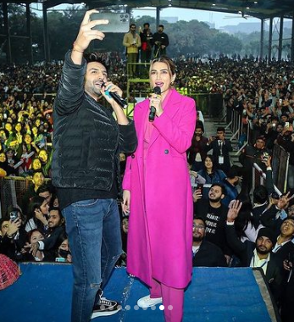
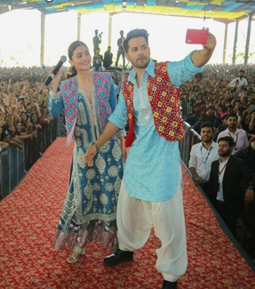
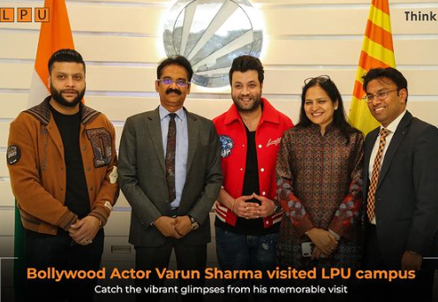
Celebrities @LPU

Slide 22
SPORTS: Stay Fit, Stay Healthy @ LPU

Slide 23
Indoor Sports Stadium

Slide 24
Student Placements

Slide 25
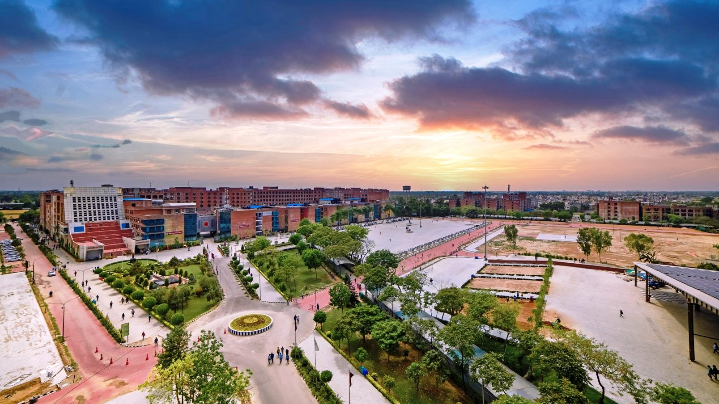
About Centre for Distance and Online Education (CDOE)

Slide 26
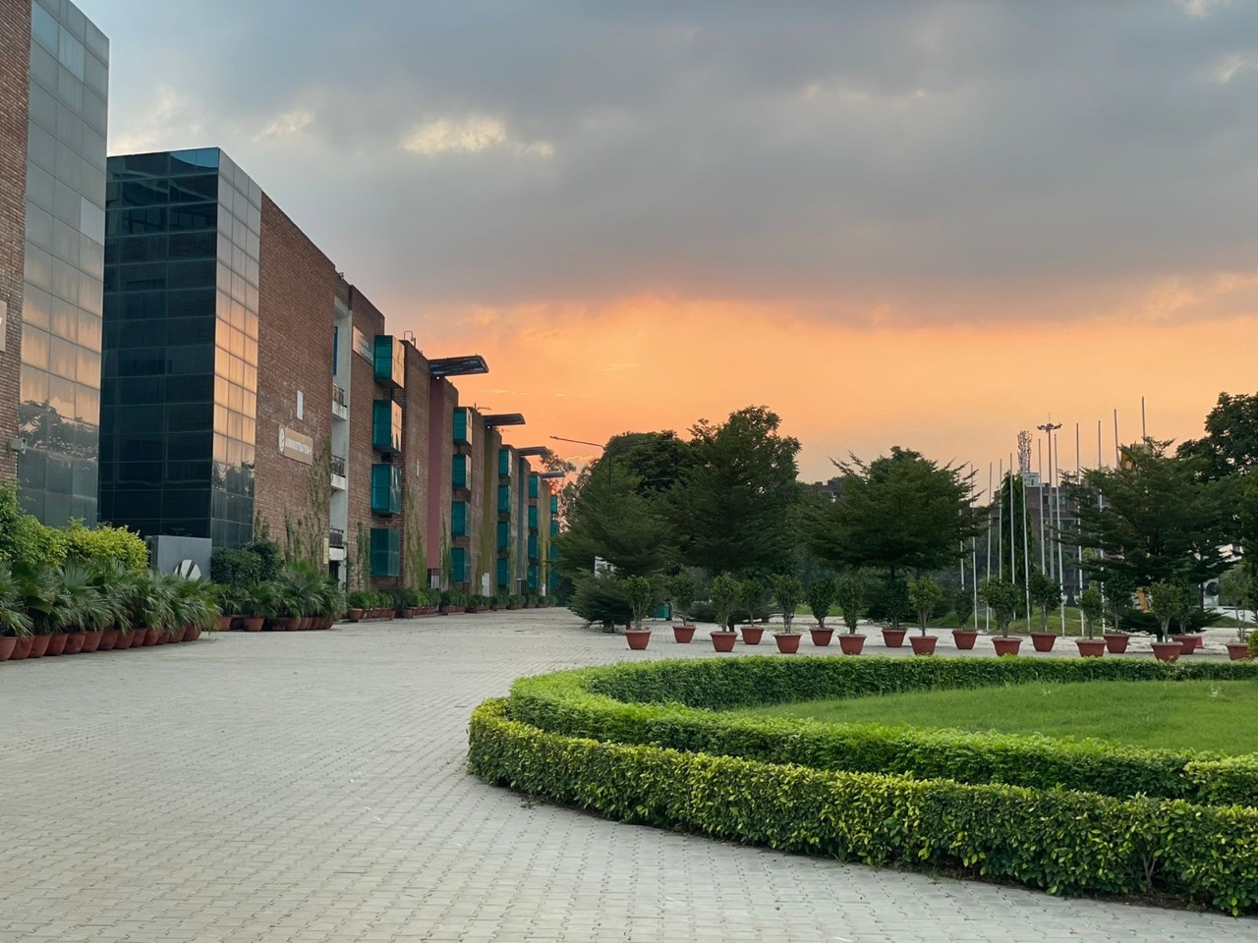
Offering Programmes in:
Open & Distance Learning (ODL)/ Distance Education Mode
Online Learning Mode
Centre for Distance and Online Education is situated at Block 29 and Block 30 in University Campus.

Slide 27
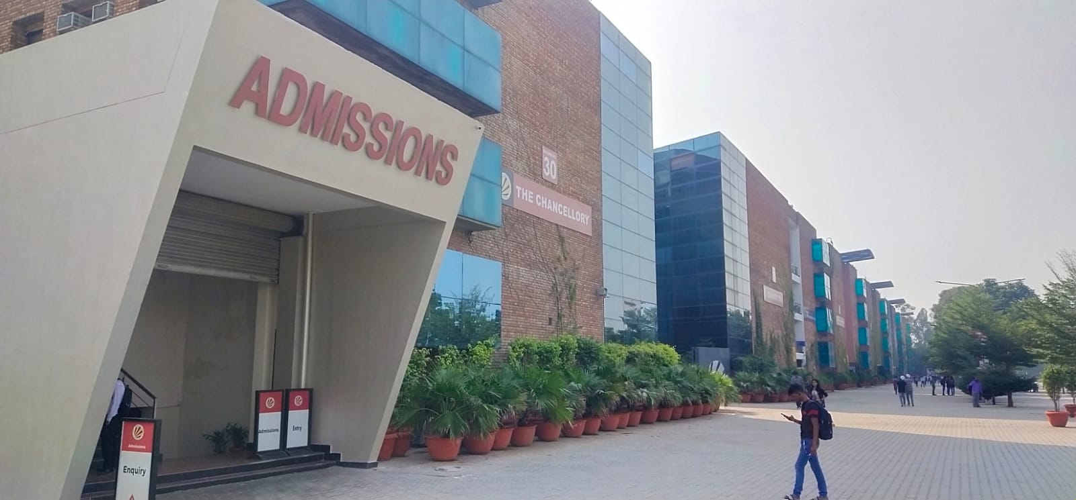
Location of Centre for Distance & Online Education (Block 29-30)

Slide 28
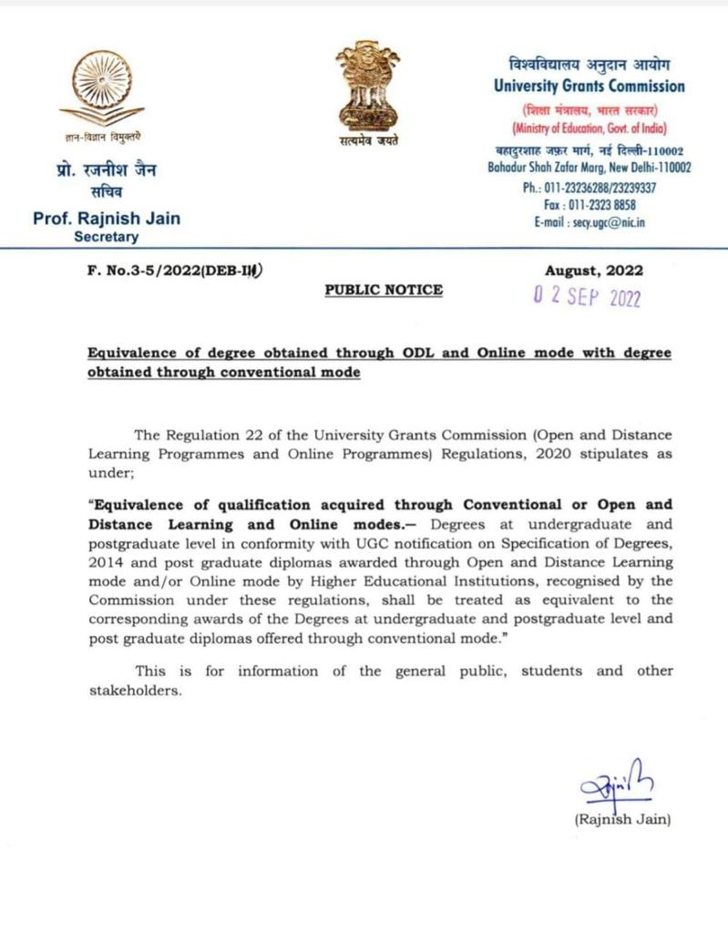
ODL and Online Degrees at par with Conventional Mode (Regular)

Slide 29
Recognitions for LPU Online Programmes
Entitled by University Grants Commission to offer Online Programmes.
MBA, MCA Programmes approved by All India Council of Technical Education (AICTE)
S. No. | Session | Letter
1 | UGC Entitlement
2 | AICTE Approval
Click here
Click Here

Slide 30
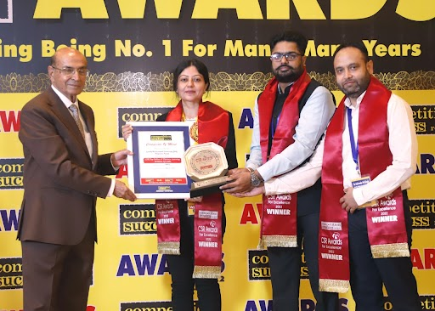
Rankings & Awards
LPU bags Top Online and Distance Learning Institute of India Award 2022 from 'Competition Success Review’ Magazine

Slide 31
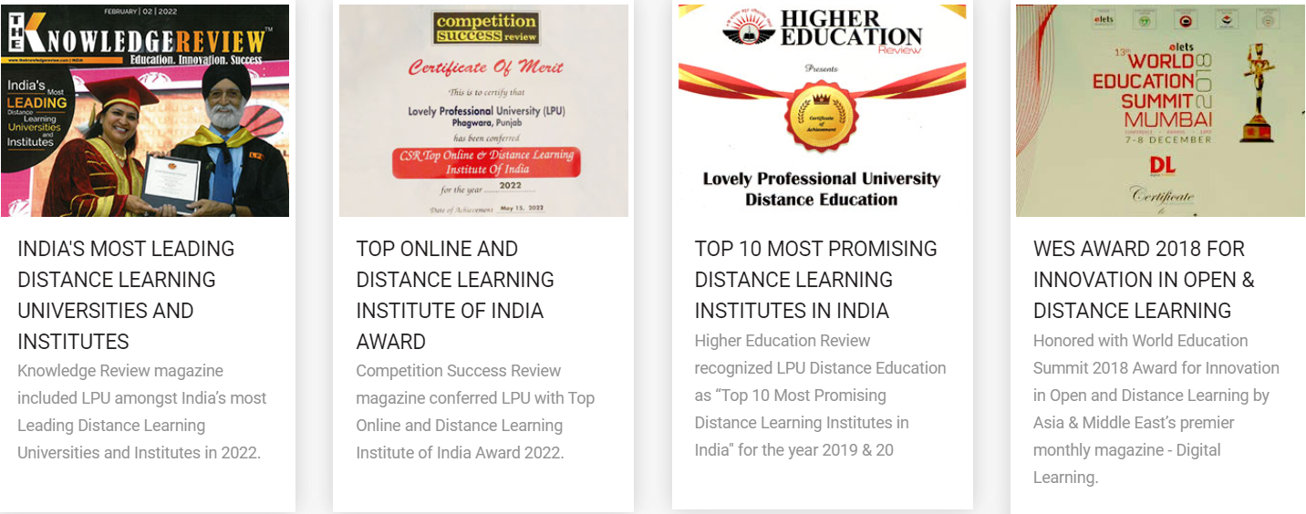
Rankings & Awards

Slide 32
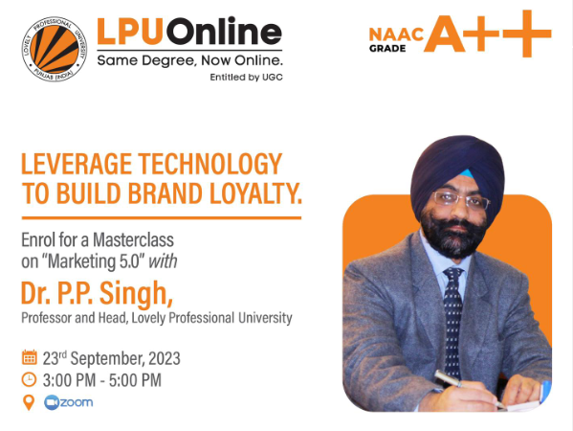
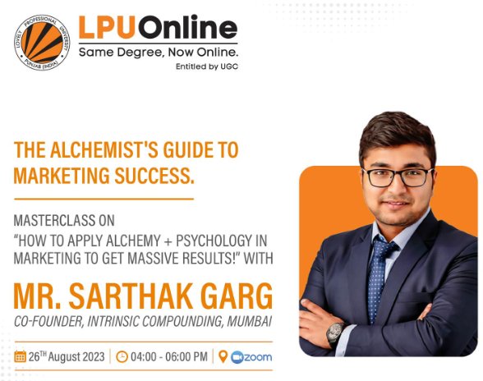
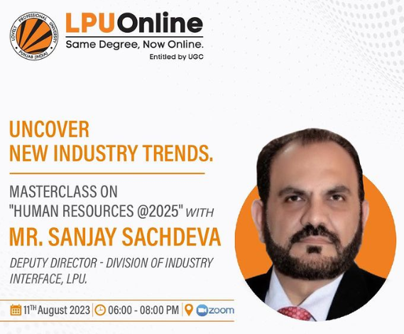
LPU Online virtual events
LPU Online virtual events

Slide 33
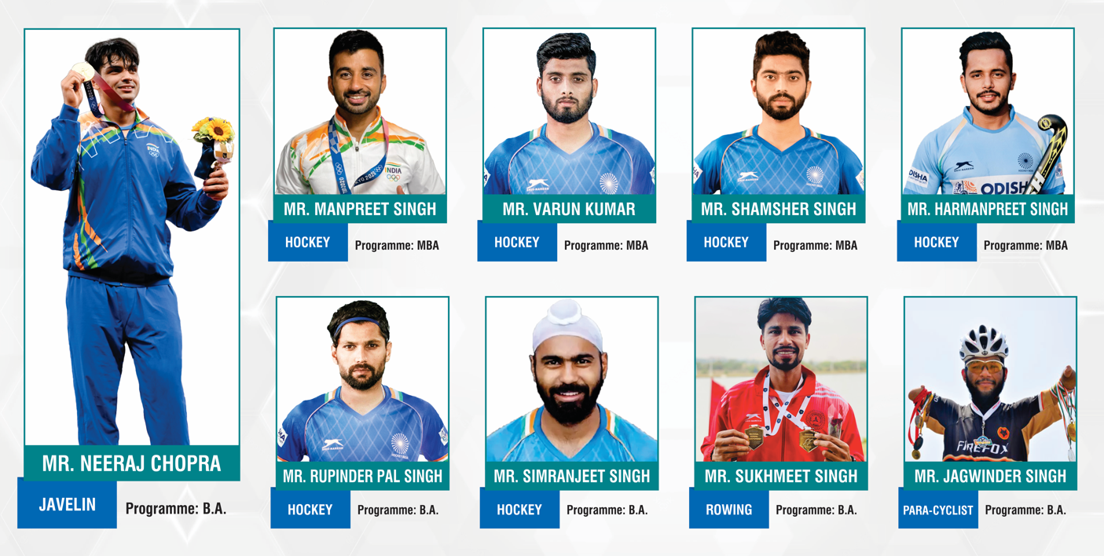
LPU ODL Students making India proud at International Level Sports

Slide 34
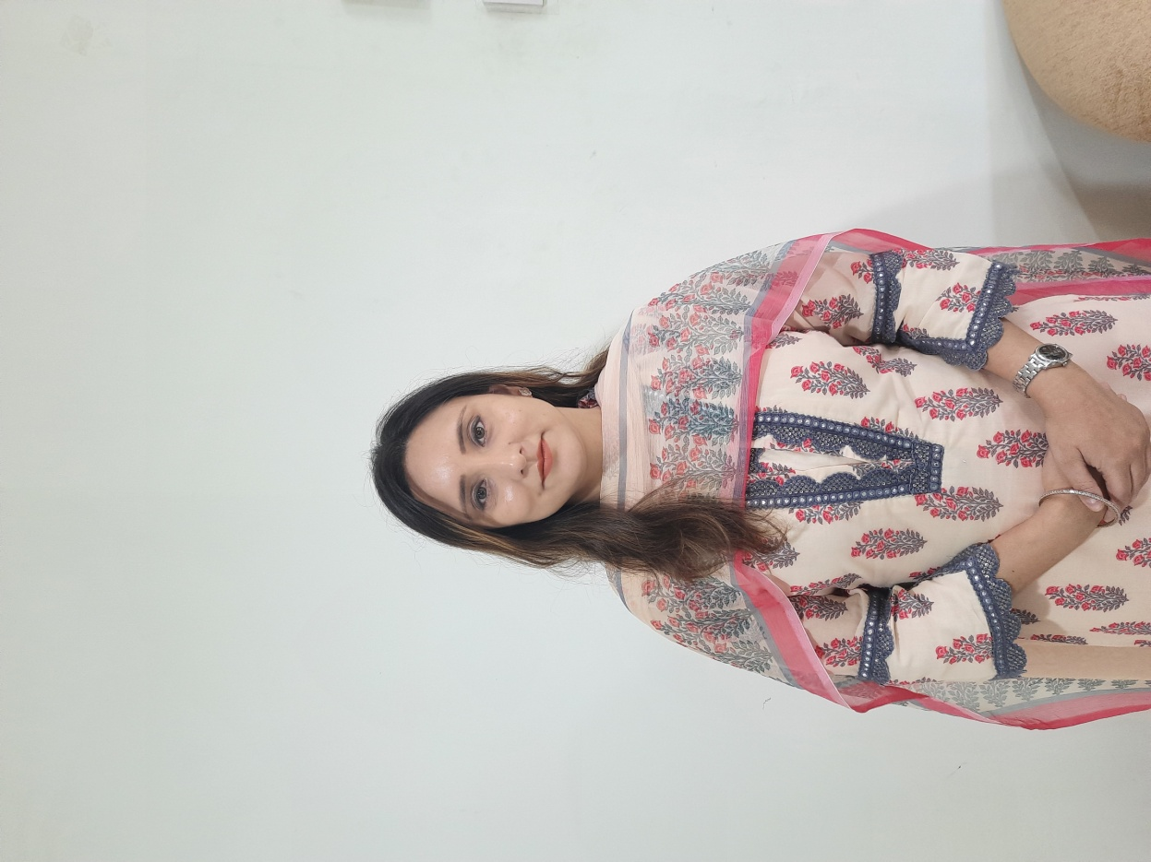
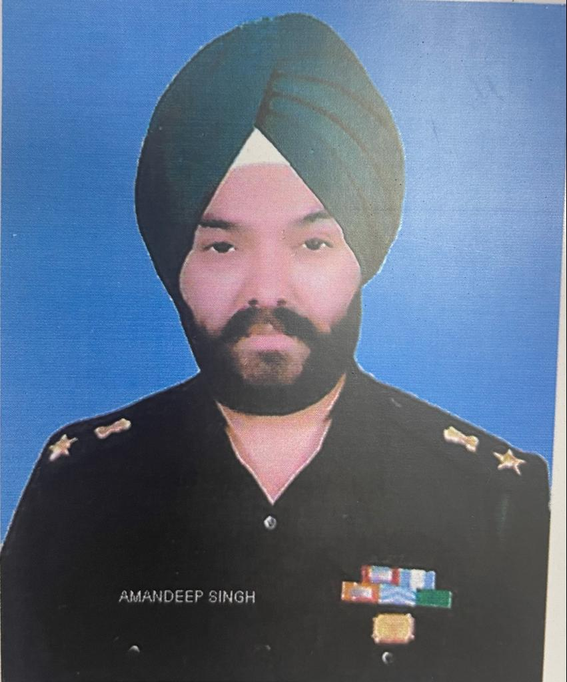
Some of the other Prominent LPU ODL Students
Dr. Tarundeep Kaur,
Additional Income Tax Commissioner,
MBA Student
Dr. Kanchan Garg,
Joint Income Tax Commissioner,
MBA Student
Mr. Amandeep Singh,
Lt. Colonel in Indian Army, MBA Student

Slide 35
Some of the Prominent LPU Online Students

Slide 36
NOTABLE ODL ALUMNI
1 LAKH+ ALUMNI TREADING THE PATH OF SUCCESS IN VARIOUS WALKS OF LIFE
Former Chairperson,
State Women Commission
Punjab

Slide 37
ALUMNI ACHIEVEMENTS
LPU Distance Education alumni who are the proud recipients of LPU Alumni awards 2023

Slide 38
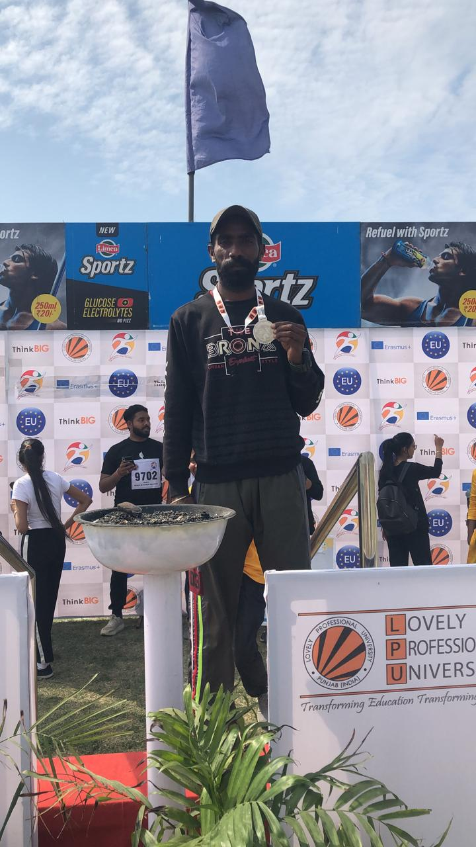
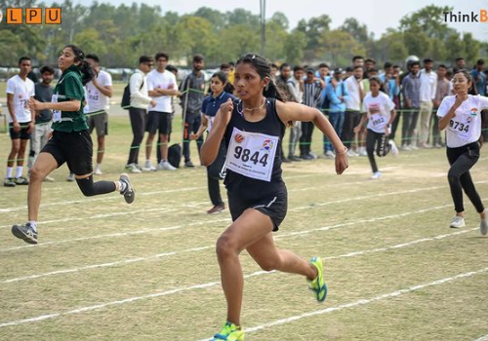
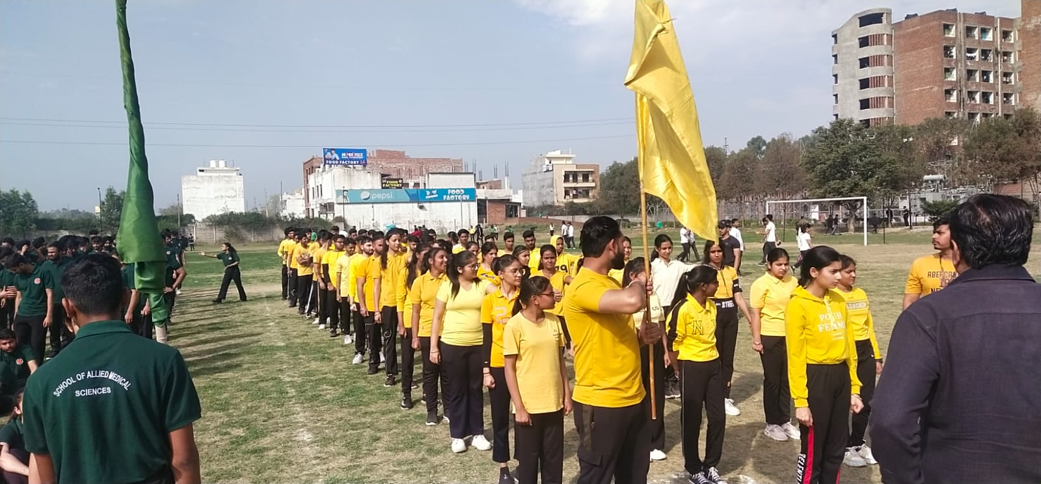
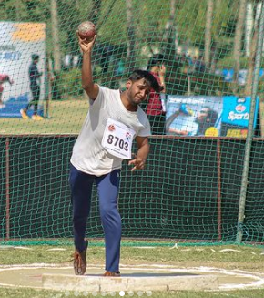
STUDENT ACHIEVEMENTS
Achievements & Participation in University Sports Meet
Satnam Singh receiving Silver Medal in 5000m race (Annual Athlete meet 2023)

Slide 39
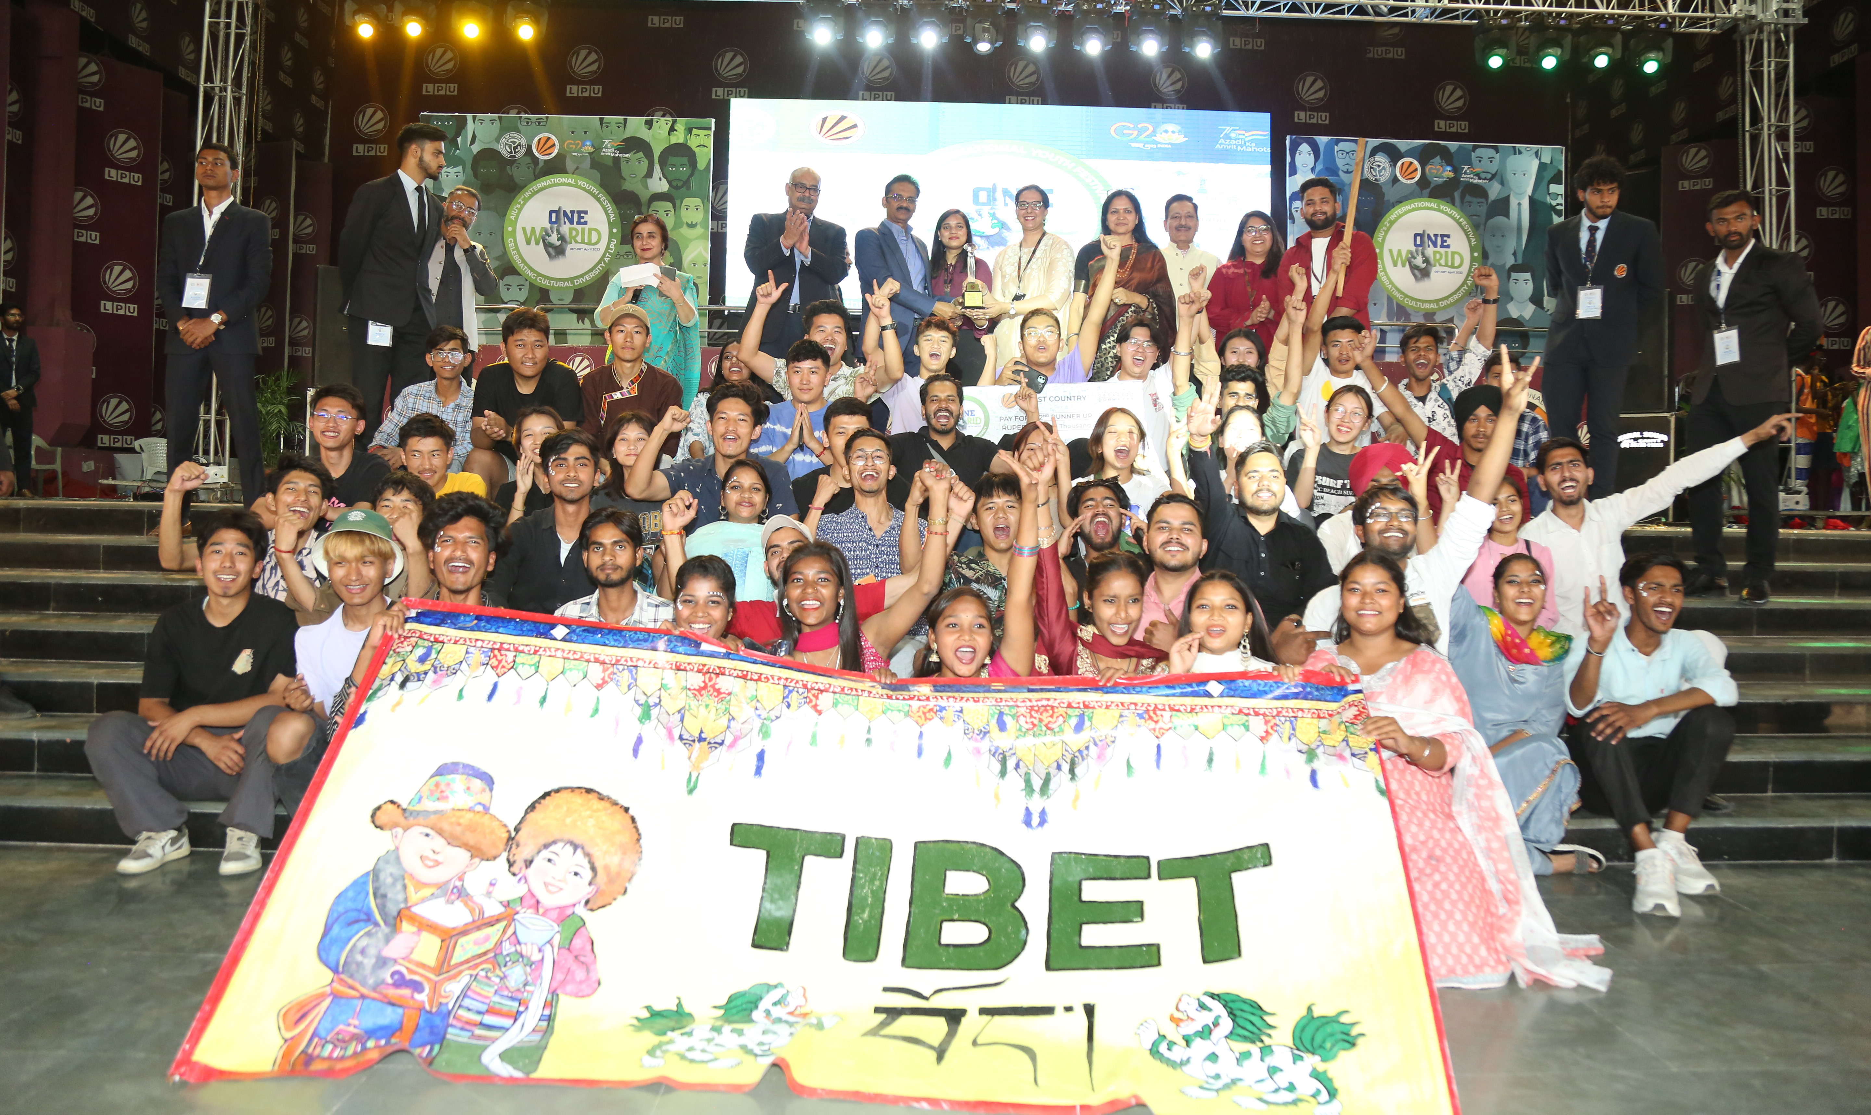
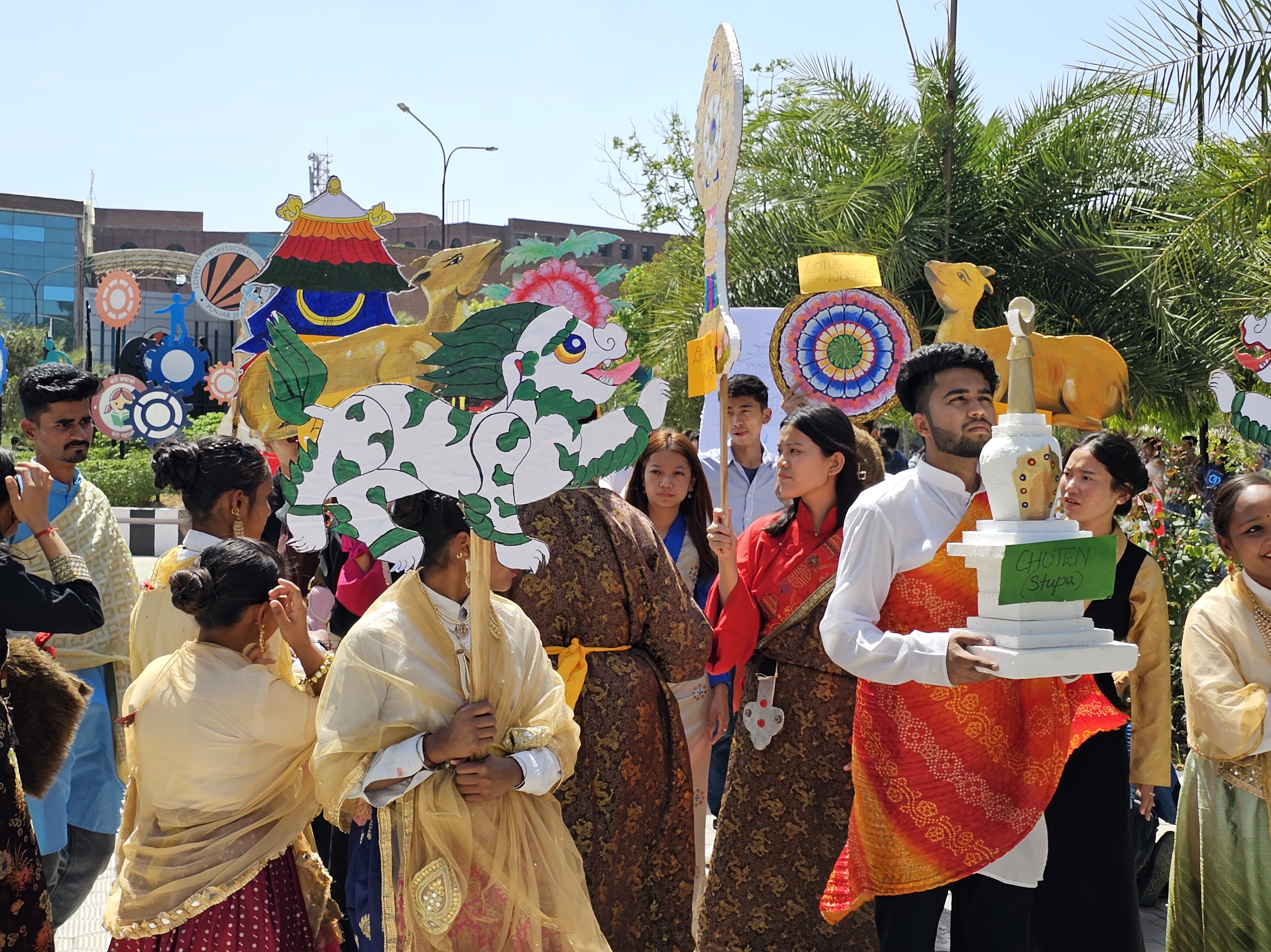
STUDENT ACHIEVEMENTS
Achievements in University Mega Event: One World
2nd runner up position for representing Tibet (April- 2023)

Slide 40
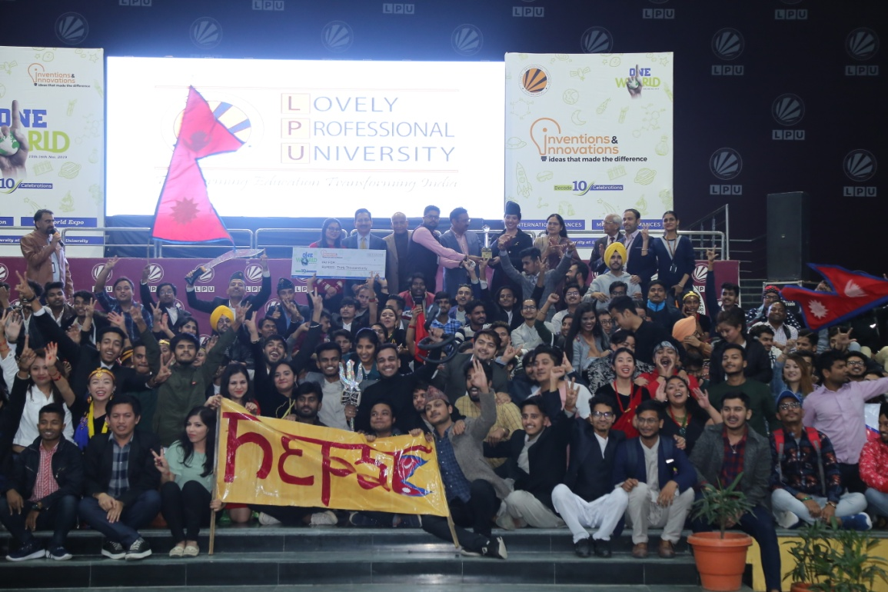
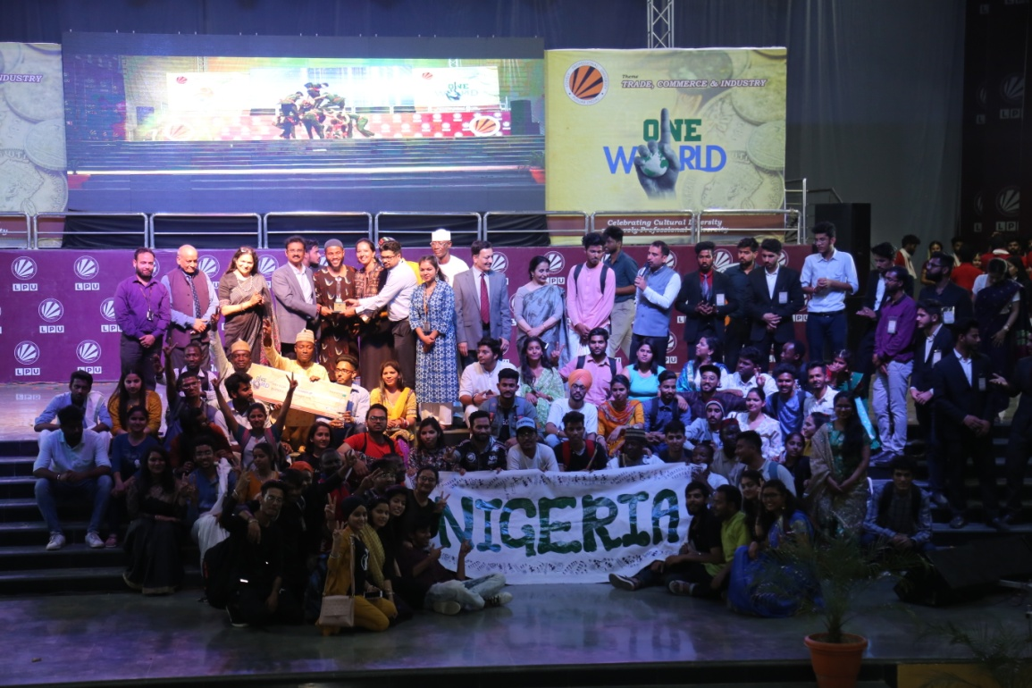
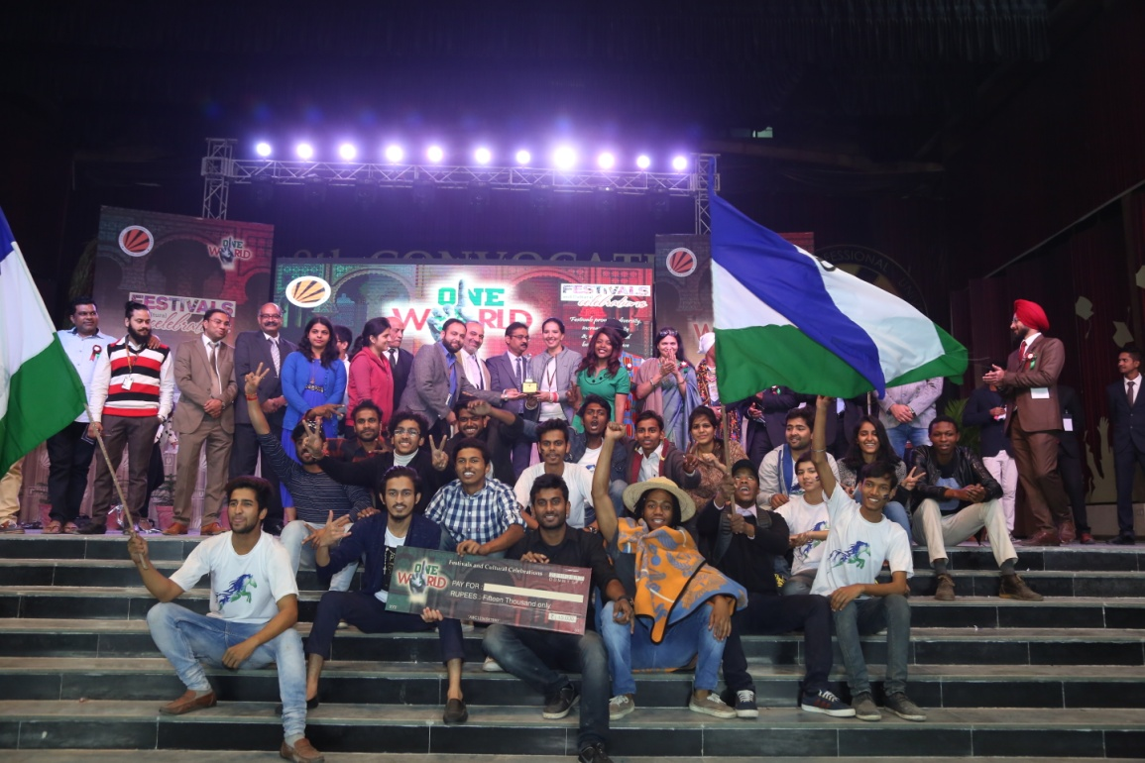
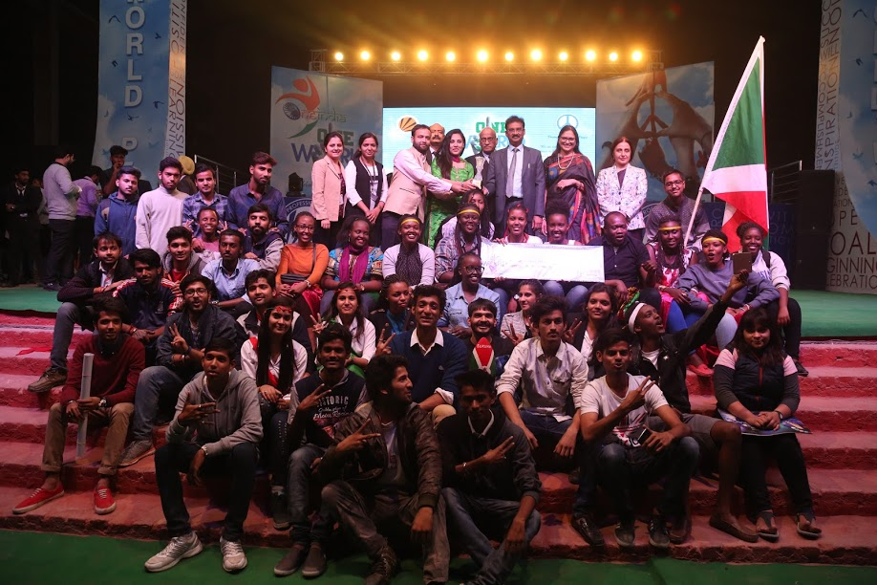
STUDENT ACHIEVEMENTS
Achievements in University Mega Event: One World
1st Runners-up for representing Nigeria
(March 2019)
1st position for representing Nepal (Nov 2019)
1st Runners-up for representing
Lesotho (2017)
2nd Runners-up for representing Burundi (2016)
2nd Runners-up for representing Sudan (2015)

Slide 41
STUDENTS ACHIEVEMENTS
Achievements in University Mega Event: One India
2nd Runners-up for representing Karnataka (2019)
2nd Runners-up for representing Sikkim (2018)
1st Runners-up for representing Nagaland
(2017)
People's Choice Award for representing Maharashtra (2016)
2nd Runners-up for representing Karnataka (2014)

Slide 42
STUDENT ACHIEVEMENTS
Achievements in University Mega Event: SPECTRA
Spectra 2020: 1st Runners-up in Overall Best performing School
Spectra 2022: Gandharav Kalia secured 2nd runner-up position in Classical Singing
1st position in Mimicry (2019)
1st position in Rangoli (2017)
Spectra 2021

Slide 43
LPU ONLINE STUDENTS PLACEMENT
For placement related information you can refer to https://www.lpuonline.com/placement.php
Prominent Recruiters:

Slide 44
LPU ONLINE STUDENTS PLACEMENT
Some Recent Placement Success Stories:

Slide 45
Visit us @LPU www.lpuonline.com

Slide 46
Thank you

